Slide 1
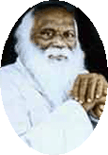
Rayat Shikshan Saanstha’s Arts, Science & Commerce College, Mokhada Dist. : Palghar
Class : S.Y.B.Sc. Semester : IV
Prepared by :- Mr. Patil Prashant K.

Slide 2
Functions of several Variables

Slide 3
CONTENTS
Introduction
Euclidean Space
Sequence in ℝ^{n}
Scalar Fields
Limit and Continuity of Scalar Valued functions

Slide 4
Introduction
In first year of B.Sc. We have studied functions and their properties of ONE variable ( f : ℝ $→$ ℝ, here domain & Co-domain are set of real numbers in one variable )
Now we focus our attention to functions of more than one variables as many of the real life applications of mathematics contains relationship with more than one variables.

Slide 5
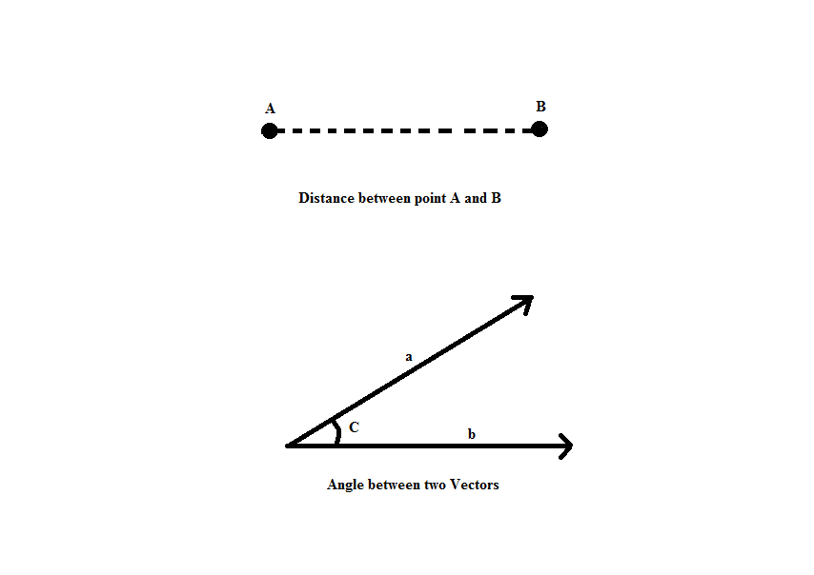
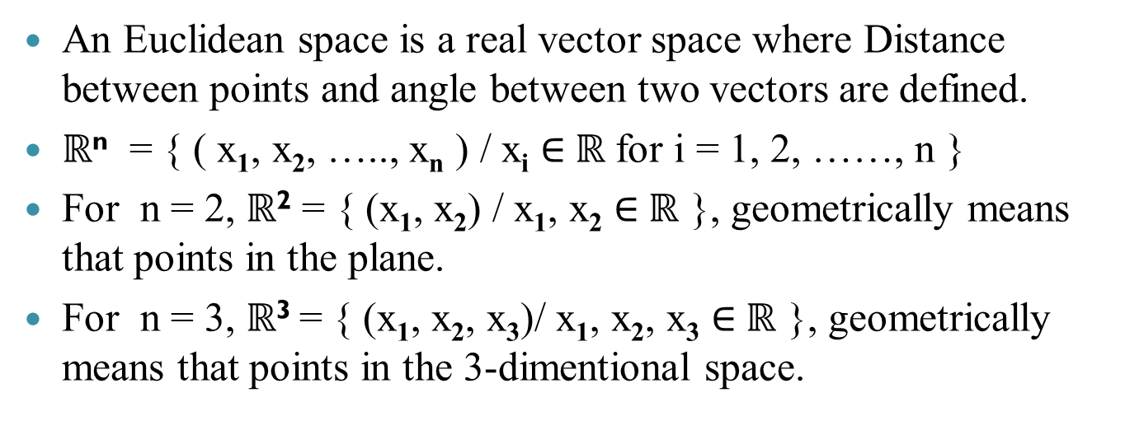
Euclidean Space
An Euclidean space is a real vector space where Distance between points and angle between two vectors are defined.
ℝ^{n} = { ( x₁, x₂, ….., x_{n} ) / x_{i} $∈$ℝ for i = 1, 2, ……, n }
For n = 2, ℝ² = { (x₁, x₂) / x₁, x₂ $∈$ℝ }, geometrically means that points in the plane.
For n = 3, ℝ³ = { (x₁, x₂, x₃)/ x₁, x₂, x₃ $∈$ℝ }, geometrically means that points in the 3-dimentional space.

Slide 6
Some Terms in Euclidean Space
Inner Product in ℝ^{n} :
Let V be a real vector space. A function < , > : V x V → ℝ
is called an Inner product if it satisfies the following
properties
i) <x, x> ≥ 0 and <x, x> = 0 if & only if x = 0.
ii) <x, y> = <y, x>
iii) <αx, y> = α <x, y>
iv) <x + y, z> = <x, z> + <y, z>
A vector space V together with an Inner product defined in it
is called as an Inner Product Space.

Slide 7
Some Terms in Euclidean Space
Dot Product in ℝ^{n} :
Let x = (x₁, x₂, ….., x_{n}) & y = (y₁, y₂, ….., y_{n}) $∈$ ℝ^{n} , then
the function · : ℝ^{n} xℝ^{n} → ℝ^{n} defined by
x$∙$y = x₁y₁ + x₂y₂ + ………… + x_{n}y_{n} is called Dot product
function.
Norm of a vector in ℝ^{n}:
Let x = (x₁, x₂, ….., x_{n}) be a vector, then Norm of vector
x, denoted by || x || is given by
|| x || = $\sqrt{x∙x}$ = $\sqrt{x_{1}^{2}+x_{2}^{2}+⋯+x_{n}^{2}}$

Slide 8
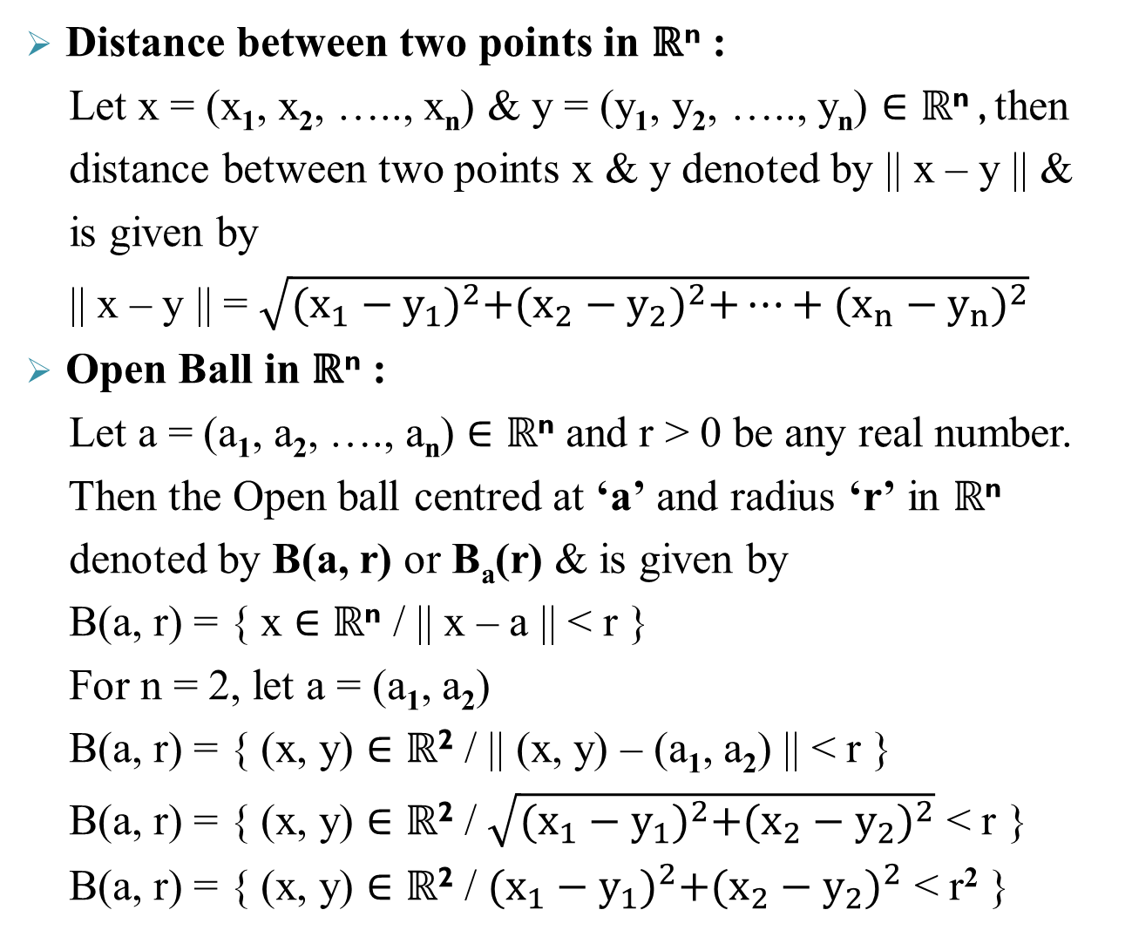
Distance between two points in ℝ^{n} :
Let x = (x₁, x₂, ….., x_{n}) & y = (y₁, y₂, ….., y_{n}) $∈$ ℝ^{n} , then
distance between two points x & y denoted by || x – y || &
is given by
|| x – y || = $\sqrt{{(x_{1}−y_{1})}^{2}+{(x_{2}−y_{2})}^{2}+⋯+{(x_{n}−y_{n})}^{2}}$
Open Ball in ℝ^{n} :
Let a = (a₁, a₂, …., a_{n}) $∈$ ℝ^{n} and r > 0 be any real number.
Then the Open ball centred at ‘a’ and radius ‘r’ in ℝ^{n}
denoted by B(a, r) or B_{a}(r) & is given by
B(a, r) = { x $∈$ ℝ^{n} / || x – a || < r }
For n = 2, let a = (a₁, a₂)
B(a, r) = { (x, y) $∈$ ℝ² / || (x, y) – (a₁, a₂) || < r }
B(a, r) = { (x, y) $∈$ ℝ² / $\sqrt{{(x_{1}−y_{1})}^{2}+{(x_{2}−y_{2})}^{2}}$ < r }
B(a, r) = { (x, y) $∈$ ℝ² / ${(x_{1}−y_{1})}^{2}+{(x_{2}−y_{2})}^{2}$ < r² }
a
r

Slide 9
Open Set
Definition :
Let S ⊆ ℝ^{n} be any subset of ℝ^{n}. S is said to be an open set if for every a ∈ S there exists r > 0 such that B(a, r) ⊆ S.
Remarks :
1) An open set contains open ball around each of its points.
2) An Open ball is an Open set.
Example :
Let S = {(x, y) / x > 0}. i.e. S is the right half plane in . Then, S is an open set.
(x₀, y₀)

Slide 10
Neighbourhood of a Point in ℝ^{n}
Let p ∈ ℝ^{n} be any point in ℝ^{n}. A set S is said to be neighbourhood of p if there exists a open subset of S containing p.
i.e. if there exists a open set U such that p ∈ U ⊆ S.
Example :
for any point (9,1) x (0,1) any set S containing (0, 1) x (0, 1) is a neighbourhood of p.

Slide 11
Closed Set in ℝ^{n}
Let S ⊆ ℝ^{n} be a non-empty subset of ℝ^{n}. S is said to closed in if S^{c} is open in ℝ^{n}.
Example :
The set S = {(x, y) ∈ ℝ² / x ≤ 0}is a Closed subset of ℝ² as the set given by S^{c} = {(x, y) ∈ ℝ² / x > 0} is an Open set in ℝ² .
Remark :
The set A = {(x, y) ∈ ℝ² / 0 < x + y ≤ 1}is neither open nor closed in ℝ².

Slide 12
Sequences in ℝ^{n}
Definition :
A function f : ℕ → ℝ^{n} is called a sequence in ℝ^{n}.
Let f(m) = x_{m}. We denote sequence by (x_{m}) where x_{m} ∈ ℝ^{n}
has n coordinates & we write
x_{m} = ($x_{m}^{(1)}, x_{m}^{(2)}, ……., x_{m}^{(n)}$)
Example :
x_{m} = ($\frac{2}{m}, \frac{{1+(−1)}^{m}}{3m−4}, {5m}^{3}$) is a sequence in ℝ³.

Slide 13
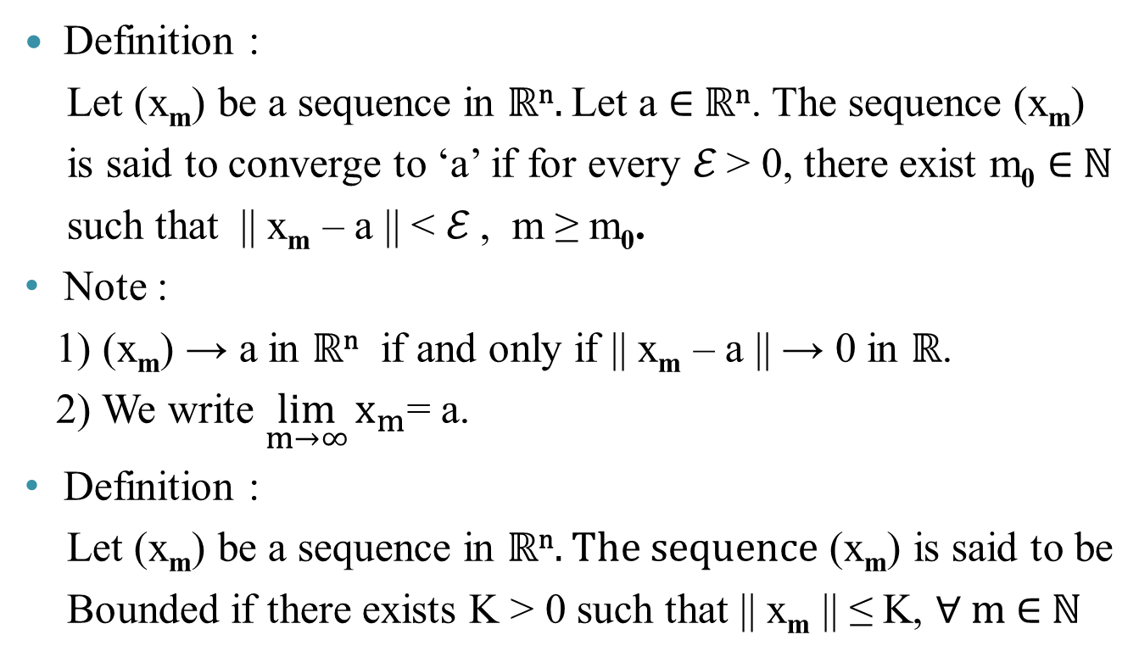
Convergence of Sequence
Definition :
Let (x_{m}) be a sequence in ℝ^{n}. Let a ∈ ℝ^{n}. The sequence (x_{m})
is said to converge to ‘a’ if for every ℰ > 0, there exist m₀ ∈ ℕ
such that || x_{m} – a || < ℰ , m ≥ m₀.
Note :
1) (x_{m}) → a in ℝ^{n} if and only if || x_{m} – a || → 0 in ℝ.
2) We write $\lim_{m→∞}{x_{m}}$= a.
Definition :
Let (x_{m}) be a sequence in ℝ^{n}. The sequence (x_{m}) is said to be
Bounded if there exists K > 0 such that || x_{m} || ≤ K, ∀ m ∈ ℕ

Slide 14
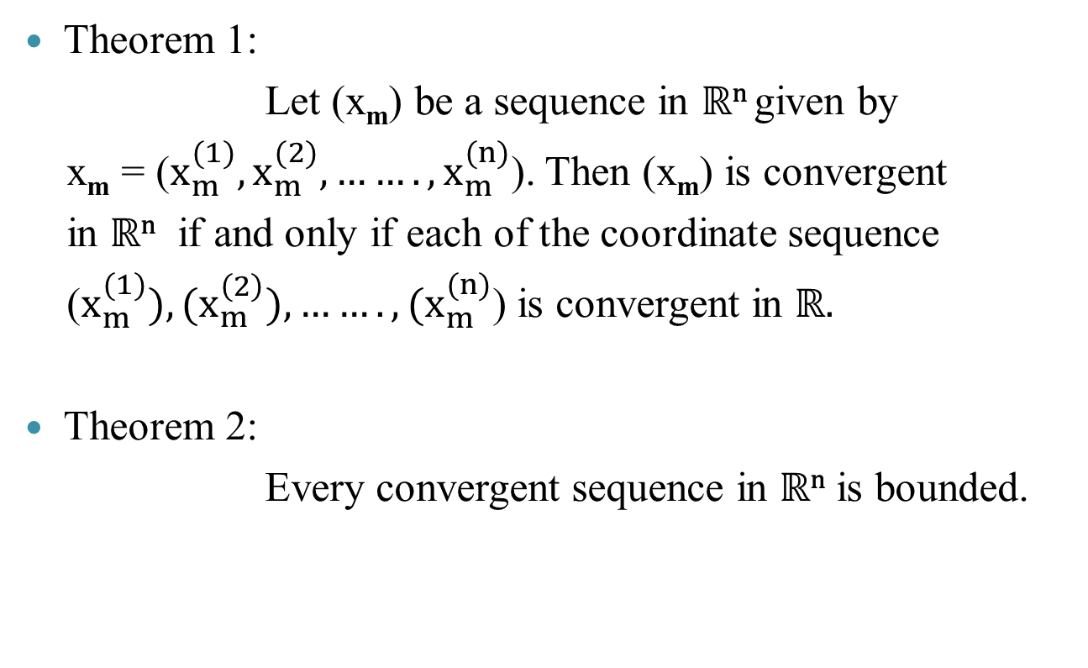
Some Important Theorems
Theorem 1:
Let (x_{m}) be a sequence in ℝ^{n} given by
x_{m} = ($x_{m}^{(1)}, x_{m}^{(2)}, ……., x_{m}^{(n)}$). Then (x_{m}) is convergent
in ℝ^{n} if and only if each of the coordinate sequence
($x_{m}^{(1)}), (x_{m}^{\left(2\right)}), ……., {(x}_{m}^{(n)}$) is convergent in ℝ.
Theorem 2:
Every convergent sequence in ℝ^{n} is bounded.

Slide 15
Scalar Field
Definition : Let S ⊆ ℝ^{n} be a non-empty open subset of ℝ^{n}. A function f : S → ℝ is a function with domain S ⊆ ℝ^{n} and codomain ℝ and is called a scalar field.

Slide 16
Limit and of Scalar Valued functions
Definition :
Let S ⊆ ℝ^{n} be a non-empty open subset of ℝ^{n}.
A function f : S → ℝ is a Scalar field. Let a ∈ S. A real
number l ∈ ℝ is said to be the limit of function f at a if
for every ℰ > 0, there exists δ > 0 such that
|| x – a || < δ ⟹ | f(x) – l | < ℰ
Example :
f : defined by
f(x, y) = x·sin(1/y) + y·cos(1/x) for (x, y) ≠ (0, 0)
= 0 otherwise

Slide 17
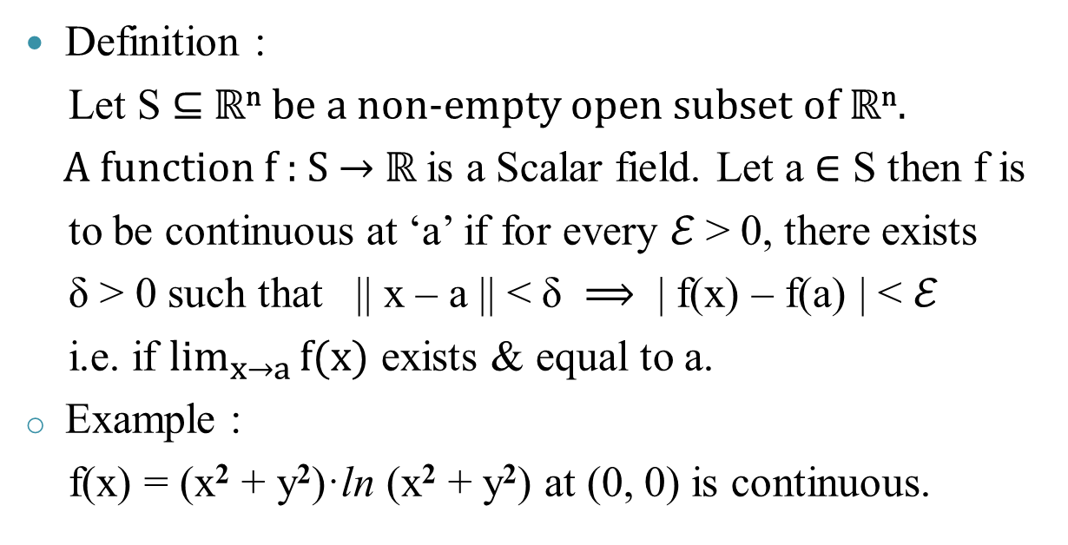
Continuity of Scalar Valued functions
Definition :
Let S ⊆ ℝ^{n} be a non-empty open subset of ℝ^{n}.
A function f : S → ℝ is a Scalar field. Let a ∈ S then f is
to be continuous at ‘a’ if for every ℰ > 0, there exists
δ > 0 such that || x – a || < δ ⟹ | f(x) – f(a) | < ℰ
i.e. if $\lim_{x→a}{f(x)}$ exists & equal to a.
Example :
f(x) = (x² + y²)·ln (x² + y²) at (0, 0) is continuous.

Slide 18
THANK YOU !

